Slide 1
SQL-99
Schema Definition
Basic Constraints
Queries

Slide 2
SQL - The Relational Database Standard
SQL → Structured Query Language
A high-level declarative language interface.
includes some features from relational algebra
It is based to a greater extent on the tuple relational calculus
SQL is a comprehensive database language. it include
statements for data definition,
statements for query,
statements for update.
[it is both a DDL (Data Definition Language) and a DML (Data Manipulation Language).]

Slide 3
SQL - The Relational Database Standard
In addition, it has facilities for
defining views on the database
specifying security and authorization
defining integrity constraints
specifying transaction controls
Allows embedding SQL statements into a general-purpose programming language(C ,C++, java ,Visual basic ...)

Slide 4
Topics to be discussed
SQL Data Definition and Data Types
Specifying Basic Constraints in SQL
Schema Change Statements
Basic Queries in SQL
More Complex Queries
Insert , delete and update statements in SQL
Additional features of SQL
Views (Virtual Tables) in SQL
Database Programming : Issues and Techniques
Embedded SQL

Slide 5
SQL DATA DEFINITION AND
DATA TYPES

Slide 6
SQL Data Definition
In SQL terminology ,
A relation is called a table
A tuple is called a row
An attribute is called a column
CREATE statement : The main SQL command for data definition. It can used to create
schemas
tables
domains
views
Assertion
triggers

Slide 7
SQL Data Definition : Schema and Catalog Concepts
An SQL schema is identified by a schema name, and includes
an authorization identifier to indicate the user or account who owns the schema
descriptors for each element in the schema.
Schema elements include
tables
constraints
views
domains
and other constructs (such as authorization grants) that describe the schema

Slide 8
SQL Data Definition : Schema and Catalog Concepts
A schema is created via the CREATE SCHEMA statement, which can include all the schema elements’ definitions.
Example:
The following statement creates a schema called COMPANY, owned by the user with authorization identifier JSMITH
CREATE SCHEMA COMPANY AUTHORIZATION JSMITH;
In general , not all users are authorized to create schema and schema elements .
The privilege for these must be given by Database Administrator (DBA)

Slide 9
SQL Data Definition : Schema and Catalog Concepts
SQL catalog
A named collection of schemas in an SQL environment.
A catalog always contains a special schema called INFORMATION_SCHEMA
INFORMATION_SCHEMA provides information on all the element descriptors of all the schemas in the catalog to authorized users.

Slide 10
SQL Data Definition : The CREATE TABLE Command
Used to specify a new table by giving it a name and specifying its attributes and constraints
The attributes are specified first, and each attribute is given a name
Followed by a data type to specify its domain of values.
Followed by any attribute constraints such as NOT NULL.
The key, entity integrity, and referential integrity constraints can be specified—within the CREATE TABLE statement—after the attributes are declared.
Syntax :
CREATE TABLE COMPANY.EMPLOYEE… OR
CREATE TABLE EMPLOYEE ...

Slide 11
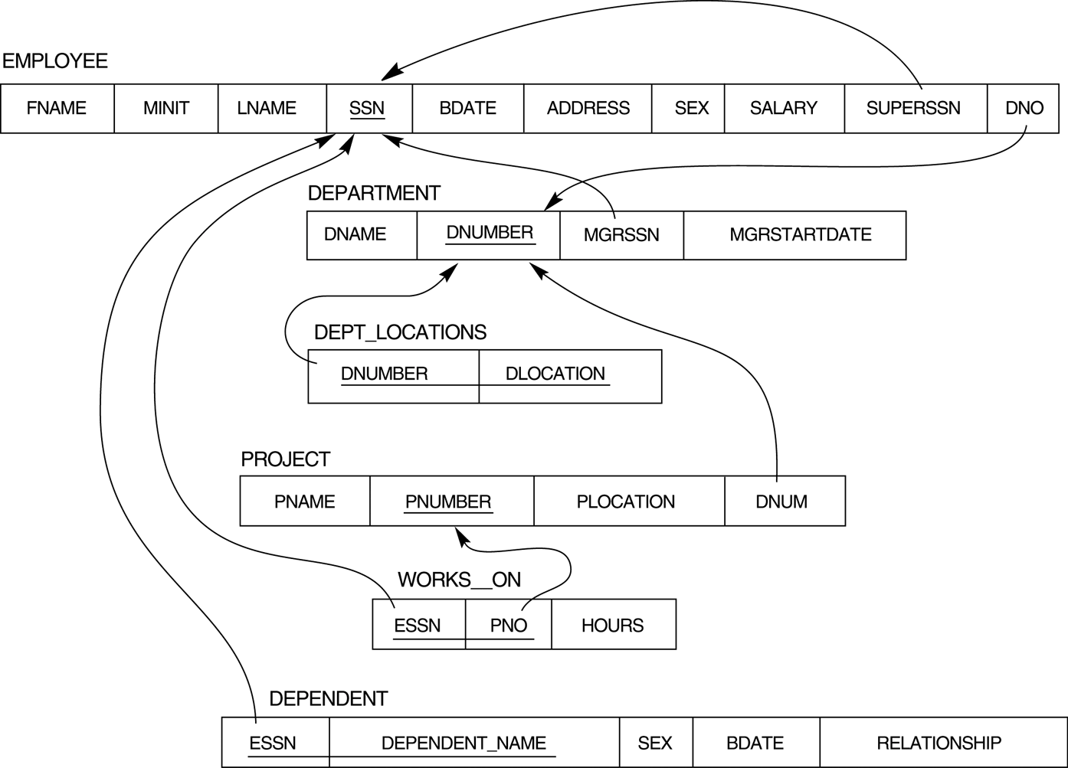
SQL Data Definition : The CREATE TABLE Command
Example : Company Database Schema

Slide 12
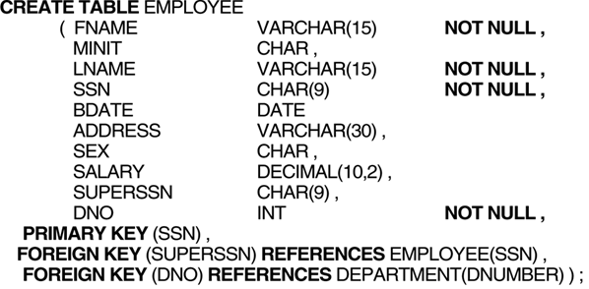
SQL Data Definition : The CREATE TABLE Command
Example : Company Database

Slide 13
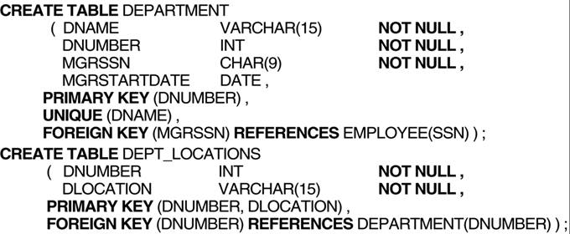
SQL Data Definition : The CREATE TABLE Command
Example : Company Database

Slide 14
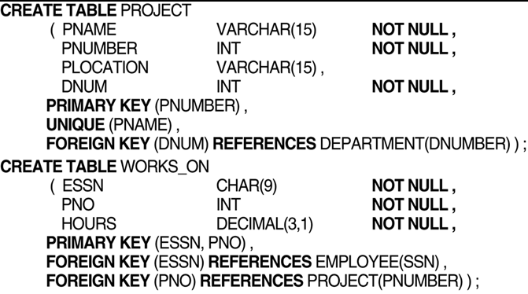
SQL Data Definition : The CREATE TABLE Command
Example : Company Database

Slide 15
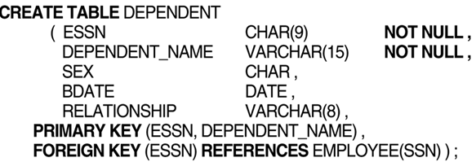
SQL Data Definition : The CREATE TABLE Command
Example : Company Database

Slide 16
SQL Data Definition : The CREATE Domain Command
Create Domain and use with attribute specification
CREATE DOMAIN SSN_TYPE AS CHAR(9)
Use SSN_TYPE in the place of CHAR(9)
Ex: SSN SSN_TYPE NOT NULL
Advantage :
Easier to change data type for domain
Improves readability

Slide 17
SQL Data Definition : The CREATE TABLE Command
The relations declared through CREATE TABLE statements are called base tables (or base relations)
The relations declared through CREATE VIEW statements are called virtual tables (or virtual relations)
In SQL the attributes in a base relation are considered to be ordered in the sequence in which they are specified in the CREATE table statement.
Rows are not considered to be ordered within a relation

Slide 18
SQL DATA Types
Numeric data types
Integer numbers of various sizes
INTERGER or INT and SMALLINT
Floating points of various precision
FLOAT or REAL
DOUBLE PRECISION
Formatted numbers can be declared by using
DECIMAL (i , j) or DEC(i , j) or NUMERIC( i , j) where i is the precision and j is the scale
Ex: DEC(10,4) means there are totally 10 digits and 4 digits after the decimal point.
The default scale is zero and default for precision is implementation defined.

Slide 19
SQL DATA Types
Character-string →2 types
Fixed-length
CHAR(n) or CHARACTER(n), where n is the number of characters.
Varying-length
VARCHAR(n) or CHAR VARYING(n) or CHARACTER VARYING(n), where n is the maximum number of characters.
Literal string value is placed between single quotation marks and it is case sensitive.
Example ‘SMITH’ and ‘smith’

Slide 20
SQL DATA Types
Bit-string → 2 types
Fixed length
BIT(n), where n is the maximum number of bits.
Varying length
BIT VARYING(n), where n is the maximum number of bits.
The default for n, the length of a character string or bit string, is 1.
Literal bit strings are placed between single quotes but precede by a B ;
Example B’10101’

Slide 21
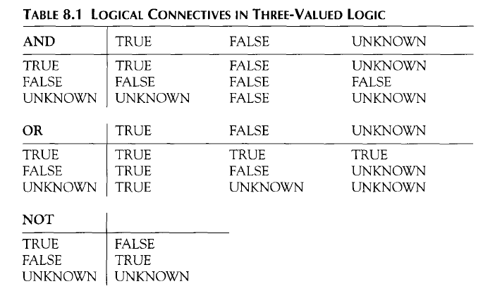
SQL DATA Types
Boolean
Traditional Values: TRUE or FALSE
Third possible values : UNKNOWN

Slide 22
SQL DATA Types
Date and Time
The DATE data type has ten positions
Typically form YYYY-MM-DD.
The TIME data type has at least eight positions
Typically form HH:MM:SS.
Literal values are represented by single quoted strings preceded by DATE or TIME
DATE’2002-09-27’ or TIME’09:12:47’
The < (less than) comparison can be used with dates or times.

Slide 23
SQL DATA Types
Date and Time
In addition, a data type TIME(i), where i is called time fractional seconds precision, specifies i + 1 additional positions for TIME-one position for an additional separator character, and i positions for specifying decimal fractions of a second.
For example Time(6) : 09:12:47 648302

Slide 24
SQL DATA Types
Timestamp
A timestamp data type (TIMESTAMP) includes both the DATE and TIME fields, plus a maximum number of six positions for decimal fractions of seconds and an optional WITH TIME ZONE qualifier
Literal values are specified as follows:
TIMESTAMP’2002-09-27 09:12:47 648302’
(Minimum one space between date and time )

Slide 25
SQL DATA Types
Interval
INTERVAL data type specifies an interval—a relative value that can be used to increment or decrement an absolute value of a date, time, or timestamp.
Intervals are qualified to be either YEAR/MONTH intervals or DAY/TIME intervals.

Slide 26
Specifying Basic Constraints in SQL-99

Slide 27
Specifying Not Null, DEFAULT and CHECK constraints
Not Null constraints :
This should always be specified for the primary key attributes of each relation,
Also for any other attributes whose values are required not to be NULL.
Example : DNAME VARCHAR(20) NOT NULL

Slide 28
Specifying Not Null, DEFAULT and CHECK constraints
DEFAULT Constraint:
To define a default value for an attribute
Example : DNO INT NOT NULL DEFAULT 1
CHECK Constraint :
To restrict the attribute or domain values.
Example :
DNUMBER INT NOT NULL CHECK (DNUMBER > 0 AND DNUMBER < 21 )

Slide 29
Specifying Key and Referential Integrity Constraints:
The PRIMARY KEY clause
Specifies one or more attributes that make up the primary key of a relation.
PRIMARY KEY (DNUMBER,DLOCATION)
If primary key single attribute then the clause can follow the attribute directly
DNUMBER INT PRIMARY KEY

Slide 30
Specifying Key and Referential Integrity Constraints:
The UNIQUE clause
Specifies alternate (or secondary) keys.
UNIQUE (DNAME)
FOREIGN KEY clause.
Specifies referential integrity constraint
FOREIGN KEY (DNO) REFERENCES DEPARTMENT(DNUMBER)

Slide 31
Specifying Key and Referential Integrity Constraints:
Options to avoid violations
The options include SET NULL, CASCADE, and SET DEFAULT.
An option must be qualified with either ON DELETE or ON UPDATE.
The action for CASCADE ON DELETE is to delete all the referencing tuples,
The action for CASCADE ON UPDATE is to change the value of the foreign key to the updated (new) primary key value for all referencing tuples.
Example:
FOREIGN KEY (DNO) REFERENCES DEPARTMENT(DNUMBER) ON DELETE SET DEFAULT ON UPDATE CASCADE.

Slide 32
Specifying Key and Referential Integrity Constraints:
Giving Names to Constraints
Constraints may be given a name, following the keyword CONSTRAINT.
Example :
CONSTRAINT DEPTPK PRIMARY KEY(DNUMBER)
The names all the constraints must be unique within a schema.
Constraints can be dropped or replaced with another constraint.
Giving names to constraints is optional.

Slide 33
Specifying Constraints on Tuples Using CHECK
These are called tuple based constraints which are specified at the end of a CREATE TABLE statement.
Example : CHECK ( DEPT_CREATE_DATE <MGRSTARTDATE);
Because a manager can start managing a department only after it is created

Slide 34
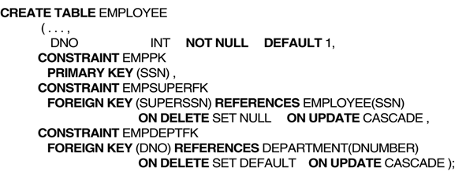
Example : Company Database

Slide 35
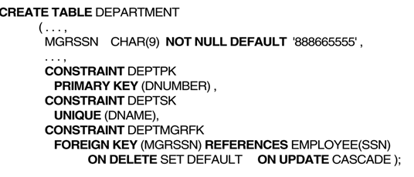
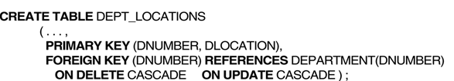
Example : Company Database

Slide 36
Schema Change Statement in SQL-99

Slide 37
The DROP Command
To drop
schema
tables
domains
constraints.
DROP has two options : CASCADE & RESTRICT
Example : DROP SCHEMA COMPANY CASCADE;
CASCADE option , when dropping a schema , will remove database schema and all its tables, domains, and other elements.
If RESTRICT option is chosen ,then schema is dropped only if it has no elements in it; otherwise, the DROP command will not be executed

Slide 38
The DROP Command
Example : DROP TABLE DEPEDENT CASCADE;
CASCADE option , when dropping a table , will remove table and all its definitions (including constraints)
RESTRICT option is chosen, the table is dropped only if it is not referenced in any constraints or views . Otherwise DROP command will not be executed.

Slide 39
The ALTER TABLE Command
To change the definition of a base table
ALTER TABLE is used to
add a column (attribute)
drop a column (attribute)
change column definition
add or dropping table constraints.

Slide 40
The ALTER TABLE Command
Examples:
ALTER TABLE EMPLOYEE ADD JOB VARCHAR(12);
ALTER TABLE EMPLOYEE DROP ADDRESS CASCADE;
ALTER TABLE DEPARTMENT ALTER MGRSSN DROP DEFAULT;
ALTER TABLE DEPARTMENT ALTER MGRSSN SET DEFAULT "333445555";
ALTER TABLE EMPLOYE DROP CONSTRAINT EMPSUPERFK CASCADE;

Slide 41
Basic Queries in SQL -99

Slide 42
The SELECT-FROM-WHERE
For retrieving information from a database
An SQL table is not a set of tuples. So any 2 tuples can be identical in all their attributes.
General form :
SELECT <attribute list>
FROM <table list>
WHERE <condition>
<attribute list> is a list of attribute names
<table list> is a list of the relation names
<condition> is a conditional (Boolean) expression
Logical Comparison Operators : =,>,<,>=,<=,<> (not equal)

Slide 43
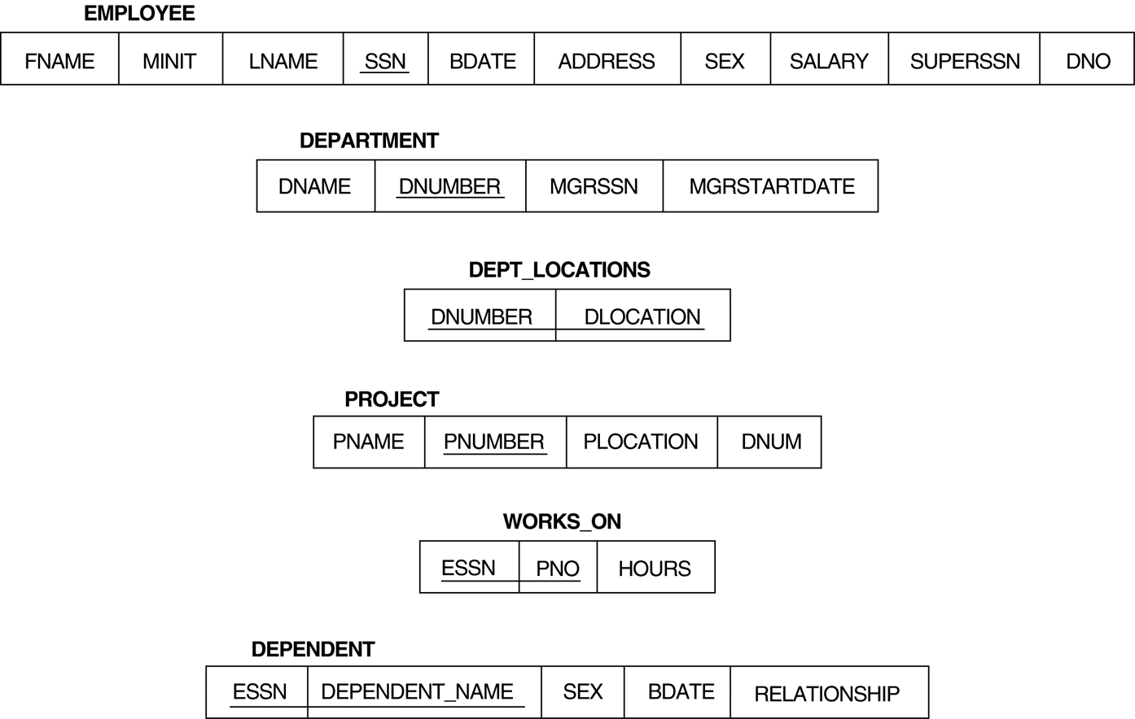
The SELECT-FROM-WHERE
Example queries on company relational schema

Slide 44
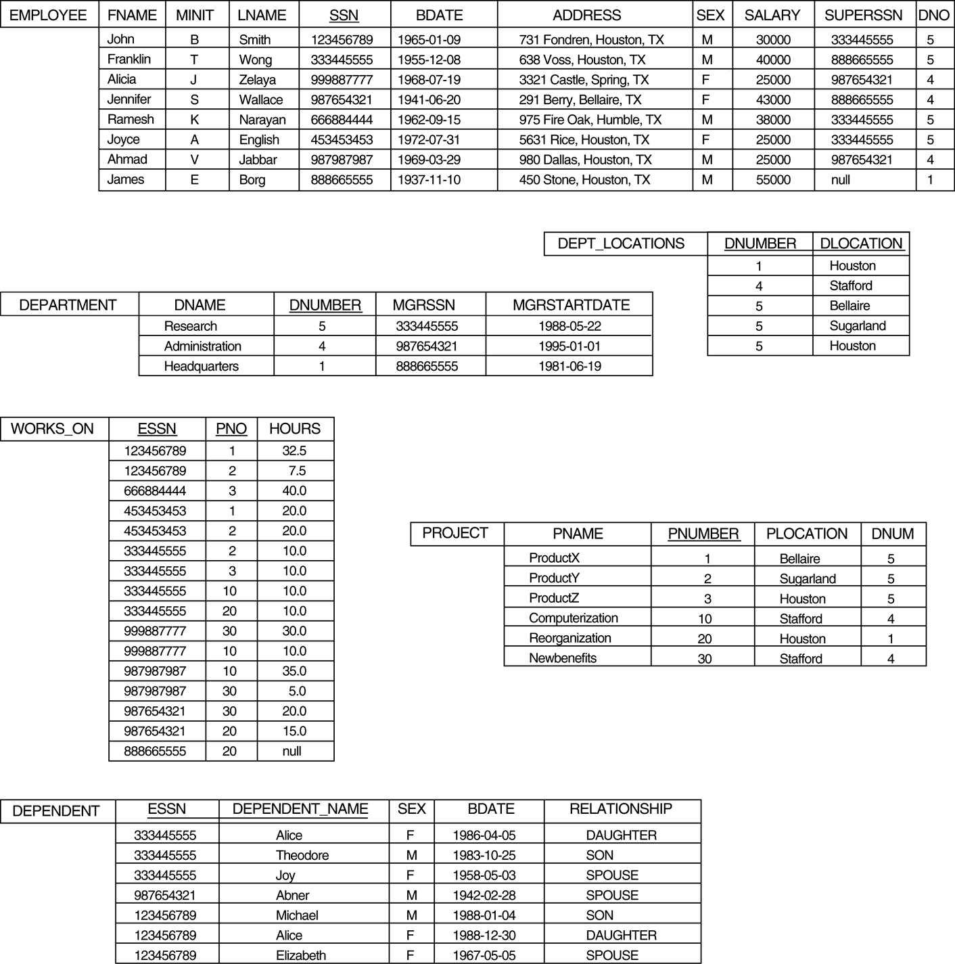
The SELECT-FROM-WHERE
Example queries on company relational schema
Populated Database

Slide 45
The SELECT-FROM-WHERE : Examples
Query 0: Retrieve the birthdate and address of the employee whose name is 'John B. Smith'.
SELECT BDATE, ADDRESS
FROM EMPLOYEE
WHERE FNAME='John' AND MINIT='B’ AND LNAME='Smith’
* the result of the query may contain duplicate tuples
Equivalent relational algebra expression
π_{BDATE , ADDRESS} (σ FNAME=‘John’ AND MINIT=‘B’ AND LNAME=‘Smith’ (EMPLOYEE))

Slide 46
The SELECT-FROM-WHERE : Examples
Query 1: Retrieve the name and address of all employees who work for the 'Research' department.
Q1: SELECT FNAME, LNAME, ADDRESS
FROM EMPLOYEE, DEPARTMENT
WHERE DNUMBER=DNO AND DNAME='Research'
Similar to a SELECT-PROJECT-JOIN sequence of relational algebra operations
(DNAME='Research') is a selection condition (corresponds to a SELECT operation in relational algebra)
(DNUMBER=DNO) is a join condition (corresponds to a JOIN operation in relational algebra)

Slide 47
The SELECT-FROM-WHERE : Examples
Query 2: For every project located in 'Stafford', list the project number, the controlling department number, and the department manager's last name, address, and birthdate.
SELECT PNUMBER, DNUM, LNAME, BDATE, ADDRESS
FROM PROJECT, DEPARTMENT, EMPLOYEE
WHERE DNUM=DNUMBER AND MGRSSN=SSN AND PLOCATION='Stafford'
In Q2, there are two join conditions and one select condition
The join condition DNUM=DNUMBER relates a project to its controlling department.
The join condition MGRSSN=SSN relates the department to the employee who manages that department.
PLOCATION='Stafford' is selection condition for Project table

Slide 48
The SELECT-FROM-WHERE : Examples

Slide 49
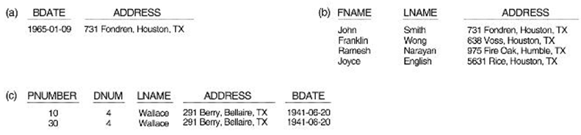
The SELECT-FROM-WHERE : Examples
Results of the SQL queries- Q0, Q1, Q2

Slide 50
Ambiguous attribute names
A query may refer to two or more attributes with the same name
In such cases, we must qualify the attribute name with the relation name
This is done by prefixing the relation name to the attribute name by using dot(.) notation to prevent ambiguity.

Slide 51
Ambiguous attribute names
Example:
Suppose that LNAME and DNO attributes of EMPLOYEE table were called NAME and DNUMBER, and DNAME attribute of the DEPARTMENT was also called NAME. then Query1 must be restated as follows.
SELECT FNAME, EMPLOYEE.NAME, ADDRESS
FROM EMPLOYEE, DEPARTMENT
WHERE DEPARTMENT.NAME='Research' AND EMPLOYEE.DNUMBER=DEPARTMENT. DNUMBER

Slide 52
Aliasing and Tuple Variables
Ambiguity also arises if some queries need to refer to the same relation twice
In this case, aliases are given to the relation name using AS
Query 8: For each employee, retrieve the employee's name, and the name of his or her immediate supervisor.
SELECT E.FNAME, E.LNAME, S.FNAME, S.LNAME FROM EMPLOYEE AS E, EMPLOYEE AS S
WHERE E.SUPERSSN=S.SSN

Slide 53
Aliasing and Tuple Variables
In Q8, the alternative relation names E and S are called aliases or tuple variables for the EMPLOYEE relation
We can think of E and S as two different copies of EMPLOYEE;
E represents employees in role of supervisees and S represents employees in role of supervisors
Use of AS is optional.
E.g. : Use EMPLOYEE E, instead of EMPLOYEE AS E,

Slide 54
Unspecified WHERE-clause
A missing WHERE-clause indicates no condition; hence, all tuples of the relations in the FROM-clause are selected.
This is equivalent to the condition WHERE TRUE
Query 9 : Retrieve the SSN values for all employees.
SELECT SSN FROM EMPLOYEE

Slide 55
Unspecified WHERE-clause
If more than one relation is specified in the FROM-clause and there is no join condition, then the CARTESIAN PRODUCT of tuples is selected.
Q 10: Retrieve the SSN values for all employees.
SELECT SSN, DNAME
FROM EMPLOYEE, DEPARTMENT;

Slide 56
Use of Asteric (*)
Used to select all the attributes.
Q1C : SELECT *
FROM EMPLOYEE
WHERE DNO=5;
Q1D : SELECT *
FROM EMPLOYEE, DEPARTMENT
WHERE DNAME=‘Research’ AND DNO=DNUMBER;
Q10A : SELECT *
FROM EMPLOYEE, DEPARTMENT;
Q10A specifies CROSS PRODUCT of EMPLOYEE and DEPARTMENT

Slide 57
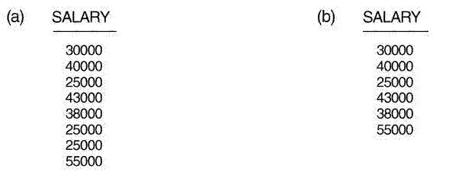


Use of DISTINCT
SQL does not treat a relation as a set; duplicate tuples can appear
DISTINCT is used to eliminate duplicate tuples
Query 11 : Retrieve the salary of every employee (Q11) and all distinct salary values (Q11A)
Q11 : SELECT SALARY FROM EMPLOYEE;
Q11A : SELECT DISTINCT SALARY FROM EMPLOYEE;

Slide 58
Set Theoretic Operations
For union , the keyword is UNION
For set difference the keyword is EXCEPT
For set intersection the keyword is INTERSECT
The relations resulting from these operations are set of tuples ; duplicates tuples are eliminated from the result.
The relations must be type compatible

Slide 59
Set Theoretic Operations

Slide 60
Set Theoretic Operations
Example for UNION:
QUERY 4 : Make a list of all project numbers for projects that involve an employee whose last name is 'Smith', either as a worker or as a manager of the department that controls the project.
(SELECT DISTINCT PNUMBER
FROM PROJECT, WORKS_ON, EMPLOYEE
WHERE PNUMBER=PNO AND ESSN=SSN AND LNAME='Smith');
UNION
(SELECT DISTINCT PNUMBER FROM PROJECT, DEPARTMENT, EMPLOYEE WHERE DNUM=DNUMBER AND MGRSSN=SSN AND LNAME='Smith‘)

Slide 61
MultiSet Operations
3 multi set operations:
UNION ALL
EXCEPT ALL
INTERSECT ALL
Their results are multi set (duplicates are not removed ) .
Basically, each tuple-whether it is a duplicate or not -is considered as a different tuple when applying these operations.

Slide 62
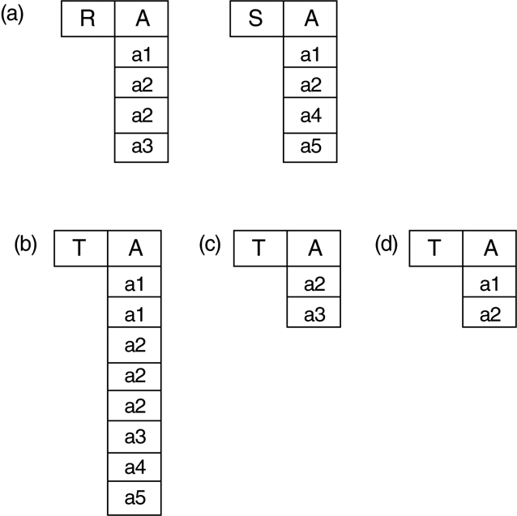
MultiSet Operations
Examples
Figure 8.5 The results of SQL multiset operations. (a) Two tables, R(A) and S(A). (b) R(A) UNION ALL S(A). (c) R(A) EXCEPT ALL S(A).
(d) R(A) INTERSECT ALL S(A).

Slide 63
Substring Pattern Matching
The LIKE comparison operator can be used for string pattern matching.
Partial strings are specified using two reserved characters:
% replaces an arbitrary number of zero or more characters
the underscore (_) replaces a single character.
QUERY 12 : Retrieve all employees whose address is in Houston.
SELECT FNAME, LNAME FROM EMPLOYEE
WHERE ADDRESS LIKE '%Houston%';

Slide 64
Substring Pattern Matching
QUERY 12A : Find all employees who were born during the 1950s.
SELECT FNAME, LNAME FROM EMPLOYEE
WHERE BDATE LIKE ‘195 _ _ _ _ _ _ _'
Date format in SQL → YYYY-MM-DD

Slide 65
Substring Pattern Matching - keyword ESCAPE.
If an underscore or % is needed as a literal character in the string, the character should be preceded by an escape character, which is specified after the string using the keyword ESCAPE.
For example:
'AB\_CD\%EF' ESCAPE '\' represents the literal string ‘AB_CD%EF', because \ is specified as the escape character
If an apostrophe (') is needed, it is represented as two consecutive apostrophes (") so that it will not be interpreted as ending the string.

Slide 66
Use of Arithmetic Operators
The standard arithmetic operators for addition (+), subtraction (-), multiplication (*), and division (/) can be applied to numeric values or attributes with numeric domains.
QUERY 13 : Show the resulting salaries if every employee working on the 'ProductX' project is given a 10 percent raise.
SELECT FNAME, LNAME, 1.1 * SALARY AS INCREASED_SAL
FROM EMPLOYEE, WORKS_ON, PROJECT
WHERE SSN=ESSN AND PNO=PNUMBER AND PNAME='ProductX';

Slide 67
Use of BETWEEN
QUERY 14 : Retrieve all employees in department 5 whose salary is between $30,000 and $40,000.
Q14: SELECT * FROM EMPLOYEE
WHERE (SALARY BETWEEN 30000 AND 40000) AND DNO =5;
Note : The condition (SALARY BETWEEN 30000 AND 40000) in Q14 is equivalent to the condition ((SALARY >= 30000) AND (SALARY <= 40000)

Slide 68
Use of ORDER BY
QUERY 15 : Retrieve a list of employees and the projects they are working on, ordered by department and, within each department, ordered alphabetically by last name, first name.
Q15: SELECT DNAME, LNAME, FNAME, PNAME
FROM DEPARTMENT, EMPLOYEE, WORKS_ON, PROJECT
WHERE DNUMBER=DNO AND SSN=ESSN AND PNO=PNUMBER
ORDER BY DNAME, LNAME, FNAME;
Note : 1. The default order is in ascending order of values.
2. We can specify the keyword DESC if we want to see the result in a descending order of values.

Slide 69
Use of ORDER BY
Example
SELECT * FROM People ORDER BY FirstName, YearOfBirth, LastName

Slide 70
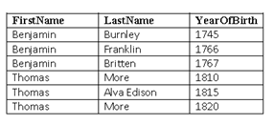
Use of ORDER BY
Example
Result:

Slide 71
More Complex SQL Queries

Slide 72
Nested Query
A Nested Query(also called a subquery) is a query embedded within another SQL Query.The result of the inner query is used by the outer query to perform further operations. Nested queries are commonly used for filtering data, performing calculations, or joining datasets indirectly.
Key Characteristics:
The inner query runs before the outer query.
The result of the inner query can be used by the outer query for comparison or as input data.
Nested queries are particularly useful for breaking down complex problems into smaller, manageable parts, making it easier to retrieve specific results from large datasets.

Slide 73
NULL value and Three-Valued Logic
SQL has 3 kinds of NULL values.
Unknown value, but existing
A particular person has a date of birth but it is not known.
Unavailable values :
we do not know whether a person has a home phone number.
Not applicable attribute value:
An attribute CollegeDegree would be NULL for a person who has no college degrees, because it does not apply to that person.

Slide 74
NULL value and Three-Valued Logic
SQL uses a three-valued logic with values TRUE, FALSE, and UNKNOWN
Table 8.1 shows the result of three-valued logic when logical connectives AND, OR, and NOT are used .

Slide 75
Use of IS or IS NOT
SQL uses IS or IS NOT to compare an attribute value to NULL.
This is because SQL considers each NULL value as being distinct from every other NULL value, so equality comparison is not appropriate.
QUERY 18 : Retrieve the names of all employees who do not have supervisors.
SELECT FNAME, LNAME FROM EMPLOYEE
WHERE SUPERSSN IS NULL;

Slide 76
Nested Queries - IN operator
Queries can be conveniently formulated by using nested queries
Nested queries are complete select-from-where blocks within the WHERE clause of another query (outer query. )
Comparison operator IN, which compares a value v with a set (multiset) of values V and evaluates to TRUE if v is one of the elements in V

Slide 77
Nested Queries - IN operator
SELECT attribute_list
FROM table_list
WHERE attr_list_1 IN (
SELECT attr_list_1
FROM table_list1
WHERE condition
)
Outer Query
Nested Query
(inner query)

Slide 78
Nested Queries - IN operator
Query 4 can be rephrased to use nested queries as shown in Q4A.
( Make a list of all project numbers for projects that involve an employee whose last name is 'Smith', either as a worker or as a manager of the department that controls the project.)
Q4A: SELECT DISTINCT PNUMBER FROM PROJECT
WHERE PNUMBER IN
(SELECT PNUMBER FROM PROJECT, DEPARTMENT, EMPLOYEE
WHERE DNUM=DNUMBER AND MGRSSN=SSN AND LNAME=‘Smith’)
OR
PNUMBER IN (SELECT PNO FROM WORKS_ON, EMPLOYEE
WHERE ESSN=SSN AND LNAME='Smith');

Slide 79
Nested Queries - IN operator

Slide 80
Nested Queries - IN operator
The IN operator can also compare a tuple of values in parentheses with a set or multiset of union-compatible tuples.
QUERY: select the SSNs of all employees who work the same (project, hours) combination on some project that employee whose SSN ='123456789’ works on.
SELECT DISTINCT ESSN FROM WORKS_ON
WHERE (PNO, HOURS) IN
(SELECT PNO, HOURS FROM WORKS_ON WHERE ESSN=‘123456789’);
In this example, the IN operator compares the subtuple of values in parentheses (PNO, HOURS) for each tuple in WORKS_ON is compared with the set of union-compatible tuples produced by the nested query.

Slide 81
Nested Queries - ANY , SOME and ALL
Used to compare a single value v (typically an attribute name) to a set or multiset V
Used with =, >,>=, <, <=, and < >.
Example : Retrieve names of employees whose salary is greater than the salary of all the employees in department 5:
SELECT LNAME, FNAME FROM EMPLOYEE
WHERE SALARY > ALL (SELECT SALARY FROM EMPLOYEE WHERE DNO=5)
The = ANY (or = SOME) operator returns TRUE if the value v is equal to some value in the set V and is hence equivalent to IN.

Slide 82
Nested Queries and Ambiguity
In general, we can have several levels of nested queries.
So ambiguity can arise if attributes of the same name exist in a relation in the FROM clause of the outer query, and another in a relation in the FROM clause of the nested query.
The rule is that a reference to an unqualified attribute refers to the relation declared in the innermost nested query.

Slide 83
Nested Queries and Ambiguity
QUERY 16 : Retrieve the name of each employee who has a dependent with the same first name and same sex as the employee.
Q16: SELECT E.FNAME, E.LNAME FROM EMPLOYEE AS E
WHERE E.SSN IN (SELECT ESSN FROM DEPENDENT WHERE E.FNAME=DEPENDENT_NAME AND E.SEX=SEX);
In the nested query of Q16, we must qualify E. SEX because it refers to the SEX attribute of EMPLOYEE from the outer query, and DEPENDENT also has an attribute called SEX.
All unqualified references to SEX in the nested query refer to SEX of DEPENDENT.
However, we do not have to qualify FNAME and SSN because the DEPENDENT relation does not have attributes called FNAME and SSN, so there is no ambiguity.

Slide 84
Correlated Nested Queries
Whenever a condition in the WHERE clause of a nested query references some attribute of a relation declared in the outer query, the two queries are said to be correlated.
We can understand a correlated query better by considering that the nested query is evaluated once for each tuple (or combination of tuples) in the outer query

Slide 85
Correlated Nested Queries
For example, we can think of Q16 as follows:
For each EMPLOYEE tuple, evaluate the nested query, which retrieves the ESSN values for all DEPENDENT tuples with the same sex and name as that EMPLOYEE tuple; if the SSN value of the EMPLOYEE tuple is in the result of the nested query, then select that EMPLOYEE tuple.

Slide 86
Correlated Nested Queries
In general, a query written with nested select-from-where blocks and using the = or IN comparison operators can always be expressed as a single block query. For example, Q16 may be written as in Q16A:
Q16A: SELECT E.FNAME, E.LNAME
FROM EMPLOYEE AS E, DEPENDENT AS D
WHERE E.SSN=D.ESSN AND E.SEX=D.SEX AND E.FNAME=D.DEPENDENT_NAME;

Slide 87
Correlated Nested Queries - EXISTS Function
The EXISTS function in SQL is used to check whether the result of a correlated nested query is empty (contains no tuples) or not.
If the result of a correlated nested query contains at least one tuple , it returns TRUE . Otherwise returns FALSE
In general, EXISTS(Q) returns TRUE if there is at least one tuple in the result of the nested query Q, and it returns FALSE otherwise.

Slide 88
Correlated Nested Queries - EXISTS Function
Query 16 in an alternative form that uses EXISTS. This is shown as QI6B:
SELECT E.FNAME, E.LNAME
FROM EMPLOYEE AS E
WHERE EXISTS (SELECT * FROM DEPENDENT WHERE E.SSN=ESSN AND E.SEX=SEX AND E.FNAME=DEPENDENT_NAME);
In general, EXISTS(Q) returns TRUE if there is at least one tuple in the result of the nested query Q, and it returns FALSE otherwise.

Slide 89
Correlated Nested Queries - NOT EXISTS Function
NOT EXISTS(Q) returns TRUE if there are no tuples in the result of nested query Q, and it returns FALSE otherwise
QUERY 6 : Retrieve the names of employees who have no dependents.
SELECT FNAME, LNAME
FROM EMPLOYEE
WHERE NOT EXISTS (SELECT * FROM DEPENDENT WHERE SSN=ESSN);

Slide 90
Correlated Nested Queries - NOT EXISTS Function
We can explain Q6 as follows:
For each EMPLOYEE tuple, the correlated nested query selects all DEPENDENT tuples whose ESSN value matches the EMPLOYEE SSN; if the result is empty, no dependents are related to the employee, so we select that EMPLOYEE tuple and retrieve its FNAME and LNAME.

Slide 91
Correlated Nested Queries (Cont…)
QUERY 7 : List the names of managers who have at least one dependent.
SELECT FNAME, LNAME FROM EMPLOYEE
WHERE
EXISTS (SELECT * FROM DEPENDENT WHERE SSN=ESSN)
AND
EXISTS ( SELECT * FROM DEPARTMENT WHERE SSN=MGRSSN);

Slide 92
Correlated Nested Queries (Cont…)
QUERY 7 works as follows
First selects all DEPENDENT tuples related to an EMPLOYEE,
Second selects all DEPARTMENT tuples managed by the EMPLOYEE.
If at least one of the first and at least one of the second exists, we select the EMPLOYEE tuple.

Slide 93
Correlated Nested Queries (Cont…)
Query 3A : "Retrieve the name of each employee who works on all the projects controlled by department number 5,”
Q3A: SELECT FNAME, LNAME
FROM EMPLOYEE
WHERE NOT EXISTS ((SELECT PNUMBER
FROM PROJECT
WHERE DNUM=5)
EXCEPT
(SELECT PNO FROM WORKS_ON WHERE
SSN=ESSN) );

Slide 94
Explicit Sets
It is also possible to use an explicit set of values in the WHERE clause, rather than a nested query. Such a set is enclosed in parentheses in SQL.
QUERY 17 : Retrieve the social security numbers of all employees who work on project numbers 1,2, or 3.
Q17: SELECT DISTINCT ESSN FROM WORKS_ON
WHERE PNO IN (1, 2, 3);

Slide 95
Renaming of Attributes in SQL
In SQL, it is possible to rename any attribute that appears in the result of a query by adding the qualifier AS followed by the desired new name. The new names will appear as column headers in the query result.
Q8A: (Retrieving the employee's name, and the name of his or her immediate supervisor.)
SELECT E.LNAME AS EMPLOYEE_NAME, S.LNAME AS
SUPERVISOR_NAME FROM EMPLOYEE AS E, EMPLOYEE AS S
WHERE E.SUPERSSN=S.SSN;

Slide 96
Joined Tables in SQL
Used to specify a table resulting from a join operation in the FROM clause of a query.
For example consider Query1, (Retrieving the name and address of every employee who works for the 'Research' department. )
SELECT FNAME, LNAME, ADDRESS
FROM EMPLOYEE, DEPARTMENT
WHERE DNUMBER=DNO AND DNAME='Research'

Slide 97
Joined Tables in SQL
The same query can be specified using Joined Table concept
First specify the join of the EMPLOYEE and DEPARTMENT relations using JOIN keyword, and then select the desired tuples and attributes.
Q1A: SELECT FNAME, LNAME, ADDRESS
FROM (EMPLOYEE JOIN DEPARTMENT ON DNO=DNUMBER)
WHERE DNAME='Research';

Slide 98
Joined Tables in SQL
Using NATURAL JOIN
Q1B: SELECT FNAME, LNAME, ADDRESS
FROM (EMPLOYEE NATURAL JOIN
(DEPARTMENT AS DEPT (DNAME, DNO, MSSN, MSDATE)))
WHERE DNAME='Research;

Slide 99
Joined Tables in SQL
Using Multiple JOINs
Q2A: SELECT PNUMBER, DNUM, LNAME, ADDRESS, BDATE
FROM ((PROJECT JOIN DEPARTMENT ON DNUM=DNUMBER)
JOIN EMPLOYEE ON MGRSSN=SSN)
WHERE PLOCATION='Stafford';

Slide 100
Aggregate Functions in SQL-99

Slide 101
COUNT, SUM, MAX, MIN, and AVG functions.
COUNT → returns the number of tuples or values as specified in a query.
SUM, MAX, MIN, and AVG → return sum, maximum value, minimum value, and average (mean) values respectively .These are applied to a set or multiset of numeric values,
All the functions can be used in the SELECT clause or in a HAVING clause
The functions MAX and MIN can also be used with attributes that have nonnumeric domains

Slide 102
COUNT, SUM, MAX, MIN, and AVG functions.
QUERY 19 : Find the sum of the salaries of all employees, the maximum salary, the minimum salary, and the average salary.
SELECT SUM (SALARY), MAX (SALARY), MIN(SALARY),AVG (SALARY) FROM EMPLOYEE;
QUERY 20 : Find the sum of the salaries of all employees of the 'Research' department, as well as the maximum salary, the minimum salary, and the average salary in this department.
Q20: SELECT SUM (SALARY), MAX (SALARY), MIN (SALARY), AVG (SALARY) FROM EMPLOYEE ,DEPARTMENT WHERE DNO=DNUMBER and
DNAME='Research';

Slide 103
COUNT, SUM, MAX, MIN, and AVG functions.
QUERY 21 : Retrieve the total number of employees
Q21: SELECT COUNT (*) FROM EMPLOYEE;
QUERY 22 : : Retrieve the total number of employees in the 'Research' department
Q22: SELECT COUNT (*) FROM EMPLOYEE,DEPARTMENT
WHERE DNO=DNUMBER AND DNAME='Research';
Here the asterisk (*) refers to the rows (tuples), so COUNT (*) returns the number of
rows in the result of the query

Slide 104
COUNT, SUM, MAX, MIN, and AVG functions.
We may also use the COUNT function to count values in a column rather than tuples, as in the next example.
QUERY 23: Count the number of distinct salary values in the database.
Q23: SELECT COUNT (DISTINCT SALARY) FROM EMPLOYEE;
If we write COUNT(SALARY) instead of COUNT(DISTINCT SALARY) in Q23, then duplicate values will not be eliminated.
Any tuples with NULL for SALARY will not be counted.
In general, NULL values are discarded when aggregate functions are applied to a particular column (attribute).

Slide 105
COUNT, SUM, MAX, MIN, and AVG functions.
We can specify a correlated nested query with an aggregate function, and then use the nested query in the WHERE clause of an outer query.
For example, to retrieve the names of all employees who have two or more dependents we can write the following:
SELECT LNAME, FNAME FROM EMPLOYEE
WHERE (SELECT COUNT (*)
FROM DEPENDENT
WHERE SSN=ESSN) >= 2

Slide 106
The GROUP BY and HAVING Clauses

Slide 107
The GROUP BY Clause
The GROUP BY clause specifies the grouping attributes
Grouping attributes should also appear in the SELECT clause,
The resulting relation contains value resulting from applying each aggregate function to a group of tuples appears along with the value of the grouping attributes.

Slide 108
The GROUP BY Clause
QUERY 24 : For each department, retrieve the department number, the number of employees in the department, and their average salary.
Q24: SELECT DNO, COUNT (*), AVG (SALARY)
FROM EMPLOYEE GROUP BY DNO;
In Q24, the EMPLOYEE tuples are partitioned into groups-each group having the same value for the grouping attribute DNO.
The COUNT and AVG functions are applied to each such group of tuples.

Slide 109
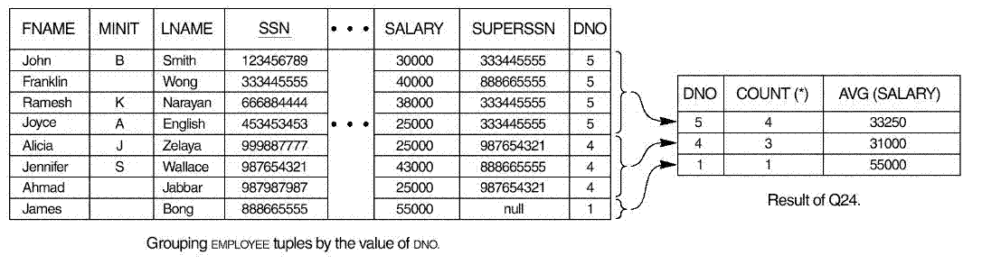
The GROUP BY Clauses
QUERY 24 :
Grouping EMPLOYEE tuples by the value of DNO
If NULLs exist in the grouping attribute, then a separate group is created for all tuples with a NULL value in the grouping attribute.

Slide 110
The GROUP BY Clauses
QUERY 25 : For each project, retrieve the project number, the project name, and the number of employees who work on that project.
SELECT PNUMBER, PNAME, COUNT (*)
FROM PROJECT, WORKS_ON
WHERE PNUMBER=PNO
GROUP BY PNUMBER, PNAME;

Slide 111
GROUP BY and HAVING Clauses
QUERY 26 : For each project on which more than two employees work, retrieve the project number, the project name, and the number of employees who work on the project.
Q26: SELECT PNUMBER, PNAME, COUNT (*) FROM PROJECT, WORKS_ON
WHERE PNUMBER=PNO GROUP BY PNUMBER, PNAME
HAVING COUNT (*) > 2

Slide 112
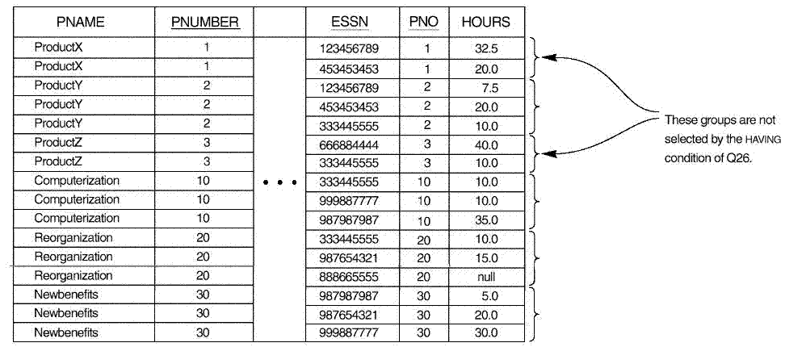
GROUP BY and HAVING Clauses
QUERY 26 : After applying the WHERE clause but before applying HAVING

Slide 113
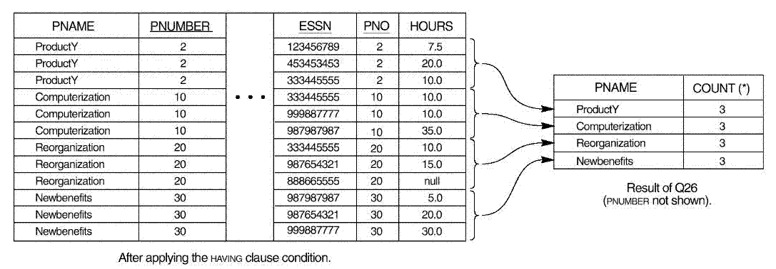
GROUP BY and HAVING Clauses
QUERY 26 : After applying the HAVING clause condition

Slide 114
GROUP BY and HAVING Clauses
QUERY 27
For each project, retrieve the project number, the project name, and the number of employees from department 5 who work on the project.
Q27: SELECT PNUMBER, PNAME, COUNT (*)
FROM PROJECT, WORKS_ON, EMPLOYEE
WHERE PNUMBER=PNO AND SSN=ESSN AND DNO=5
GROUP BY PNUMBER, PNAME;

Slide 115
GROUP BY and HAVING Clauses
QUERY 28
For each department that has more than five employees, retrieve the department number and the number of its employees who are making more than $40,000.
Q28: SELECT DNUMBER, COUNT (*)
FROM DEPARTMENT, EMPLOYEE
WHERE DNUMBER=DNO AND SALARY>40000 AND
DNO IN (SELECT DNO FROM EMPLOYEE
GROUP BY DNO
HAVING COUNT (*) > 5)
GROUP BY DNUMBER;

Slide 116
INSERT, DELETE, AND UPDATE STATEMENTS IN SQL-99

Slide 117
The INSERT Command
INSERT is used to add a single tuple to a relation.
We must specify the relation name and a list of values for the tuple.
The values should be listed in the same order in which the corresponding attributes were specified in the CREATE TABLE command.
Example : Adding a new tuple to employee table
UI: INSERT INTO EMPLOYEE VALUES ('Richard', 'K', 'Marini', '653298653', '1962-12-30', '98 Oak Forest,Katy,TX', 'M', 37000, '987654321', 4);

Slide 118
Another form of the INSERT Command :
This allows the user to specify explicit attribute names that correspond to the values provided in the INSERT command.
This is useful if a relation has many attributes but only a few of those attributes are assigned values in the new tuple.
However, the values must include all attributes with NOT NULL specification and no default value.
Attributes with NULL allowed or DEFAULT values are the ones that can be left out.

Slide 119
Another form of the INSERT Command :
For example, to enter a tuple for a new EMPLOYEE for whom we know only the FNAME, LNAME, DNO, and SSN attributes, we can use U1A:
UIA: INSERT INTO VALUES EMPLOYEE (FNAME, LNAME, DNO, SSN)
('Richard', 'Marini', 4, '653298653');
Attributes not specified in U lA are set to their DEFAULT or to NULL

Slide 120
Inserting multiple tuples using select
A variation of the INSERT command inserts multiple tuples into a relation in conjunction with creating the relation and loading it with the result of a query.
For example, to create a temporary table that has the name, number of employees, and total salaries for each department, we can write the statements in U3A and U3B:
U3A: CREATE TABLE DEPTS_INFO (
DEPT_NAME VARCHAR(15),
NO_OF_EMPS INTEGER,
TOTAL_SAL INTEGER
);

Slide 121
Inserting multiple tuples using select
U3B: INSERT INTO DEPTS_INFO (DEPT_NAME, NO_OF_EMPS, TOTAL_SAL)
SELECT DNAME, COUNT (*), SUM (SALARY)
FROM DEPARTMENT , EMPLOYEE ON
WHERE DNUMBER=DNO
GROUP BY DNAME;
A table DEPTS_INFO is created by U3A and is loaded with the summary information retrieved from the database by the query in U3B.

Slide 122
The DELETE Command
The DELETE command removes tuples from a relation. It can include WHERE clause to select the tuples to be deleted.
Tuples are explicitly deleted from only one table at a time
The deletion may propagate to tuples in other relations if referential triggered actions are specified in the referential integrity constraints of the DDL
A missing WHERE clause specifies that all tuples in the relation are to be deleted;

Slide 123
The DELETE Command
U4A: DELETE FROM EMPLOYEE WHERE LNAME='Brown';
U4B: DELETE FROM EMPLOYEE WHERE SSN='123456789';
U4C: DELETE FROM EMPLOYEE WHERE
DNO IN ( SELECT DNUMBER
FROM DEPARTMENT
WHERE DNAME='Research');
U4D: DELETE FROM EMPLOYEE; (becomes empty table)

Slide 124
The UPDATE Command
The UPDATE command is used to modify attribute values of one or more selected tuples.
As in the DELETE command, a WHERE clause in the UPDATE command selects the tuples to be modified from a single relation.
However, updating a primary key value may propagate to the foreign key values of tuples in other relations if such a referential triggered action is specified in the referential integrity constraints of the DDL
An additional SET clause in the UPDATE command specifies the attributes to be modified and their new values.

Slide 125
The UPDATE Command
For example, to change the location and controlling department number of project number 10 to 'Bellaire' and 5, respectively, we use US:
U5: UPDATE PROJECT SET PNUMBER=10 , DNUM = 5 WHERE PLOCATION = 'Bellaire‘;

Slide 126
The UPDATE Command
Several tuples can be modified with a single UPDATE command. An example is to give all employees in the 'Research' department a 10 percent raise in salary, as shown in U6.
U6: UPDATE EMPLOYEE SET SALARY = SALARY *1.1
WHERE DNO IN ( SELECT DNUMBER
FROM DEPARTMENT
WHERE DNAME='Research');
It is also possible to specify NULL or DEFAULT as the new attribute value.
Notice that each UPDATE command explicitly refers to a single relation only.

Slide 127
VIEWS (VIRTUAL TABLES) IN SQL

Slide 128
Concept of a View in SQL
A view is a single table that is derived from other tables
other tables → base tables or previously defined views
A view does not necessarily exist in physical form.
Views are useful when a table needs to be reference frequently

Slide 129

Why a View in SQL?
Suppose that we frequently issue queries that retrieve the employee name and the project names that the employee works on.
Rather than having to specify the join of the EMPLOYEE, WORKS_ON, and PROJECT tables every time we issue that query , we can define a view that is a result of these joins. We can then issue queries on the view

Slide 130
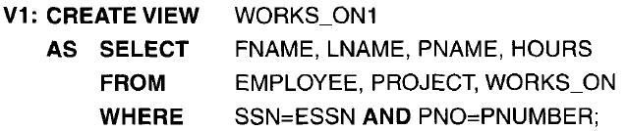
Specification of Views in SQL
the command to specify a view is CREATE VIEW.
The view is given a
view name,
a list of attribute names (Optional)
and a query to specify the contents of the view.

Slide 131
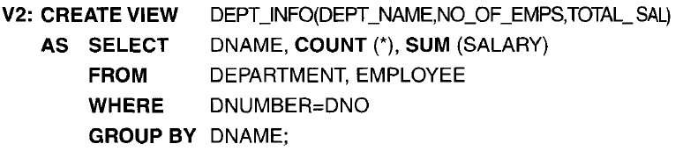
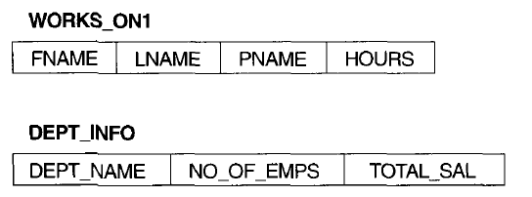
Specification of Views in SQL

Slide 132
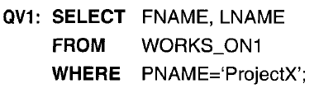
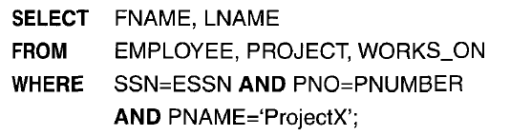
Specification of Views in SQL
We can now specify SQL queries on a view-or virtual table-in the same way we
specify queries involving base tables.
Example : to retrieve the last name and first name Of all employees who work on 'ProjectX',
Equivalent query if if specified on the base relations

Slide 133

Specification of Views in SQL
Advantages
a view is to simplify the specification of certain queries.
Views are also used as a security and authorization mechanism
A view is supposed to be always up to date;
DROP VIEW command is used to dispose a view

Slide 134
Specifying General Constraints as Assertions in SQL
Assertions are used to specify additional types of constraints outside scope of built-in relational model constraints. In SQL, users can specify general constraints via declarative assertions, using
CREATE ASSERTION <Name_of_assertion> CHECK (<cond>)
For the assertion to be satisfied, the condition specified after CHECK clause must return true.

Slide 135
The CREATE ASSERTION statement of the DDL.
Each assertion is given a constraint name and is specified via a condition similar to the WHERE clause of an SQL query.
General form :
CREATE ASSERTION <Name_of_assertion> CHECK (<cond>)
For the assertion to be satisfied, the condition specified after CHECK clause must return true.

Slide 136
Write an assertion to specify the constraint that the Sum of loans taken by a customer does not exceed 100,000
CREATE ASSERTION sumofloans
CHECK (100000> = ALL
SELECT customer_name,sum(amount)
FROM borrower b, loan l
WHERE b.loan_number=l.loan_number
GROUP BY customer_name );

Slide 137
For example, to specify the constraint that the salary of an employee must not be greater than the salary of the manager of the department that the employee works for in SQL, we can write the following assertion:

Slide 138
CREATE ASSERTION SALARY_CONSTRAINT
CHECK ( NOT EXISTS ( SELECT * FROM EMPLOYEE E, EMPLOYEE M,
DEPARTMENT D WHERE E.Salary>M.Salary AND
E.Dno=D.Dnumber AND D.Mgr_ssn=M.Ssn ) );

Slide 139
Write an assertion to specify the constraint that the Sum of loans taken by a customer does not
exceed 100,000
CREATE ASSERTION sumofloans
CHECK (100000> = ALL
SELECT customer_name,sum(amount)
FROM borrower b, loan l
WHERE b.loan_number=l.loan_number
GROUP BY customer_name );

Slide 140
Write an assertion to specify the constraint that the Number of accounts for each customer in a
given branch is at most two
CREATE ASSERTION NumAccounts
CHECK ( 2 >= ALL
SELECT customer_name,branch_name, count(*)
FROM account A , depositor D
WHERE A.account_number = D.account_number
GROUP BY customer_name, branch_name );

Slide 141
Introduction to Triggers in SQL
A trigger is a procedure that runs automatically when a certain event occurs in the DBMS.
In many cases it is convenient to specify the type of action to be taken when certain events occur and when certain conditions are satisfied.
The CREATE TRIGGER statement is used to implement such actions in SQL.

Slide 142
General form:
CREATE TRIGGER <name>
BEFORE | AFTER | <events>
FOR EACH ROW |FOR EACH STATEMENT
WHEN (<condition>)
<action>

Slide 143
A trigger has three components
1. Event: When this event happens, the trigger is activated
• Three event types : Insert, Update, Delete
• Two triggering times: Before the event

Slide 144
Exercise
Consider the following database schema:
Student(snum: integer, sname: string, major: string, level: string, age: integer)
Class(cname: string, meets_at: time, room: string, fid: integer)
Enrolled(snum: integer, cname: string)
Faculty(fid: integer, fname: string, deptid: integer)
Student Levels : Freshman(FR), Sophomore(SO), Junior(JR), Senior(SR)

Slide 145
After the event
2. Condition (optional): If the condition is true, the trigger executes, otherwise
skipped
3. Action: The actions performed by the trigger
When the Event occurs and Condition is true, execute the Action

Slide 146
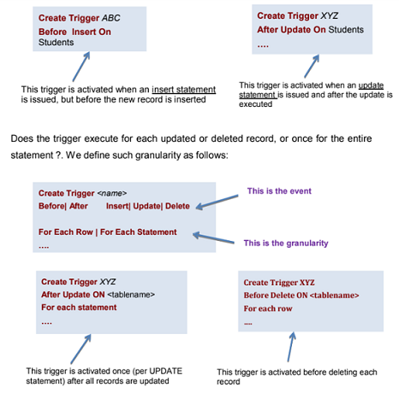

Slide 147
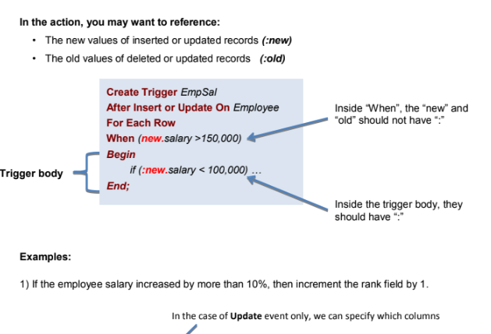

Slide 148
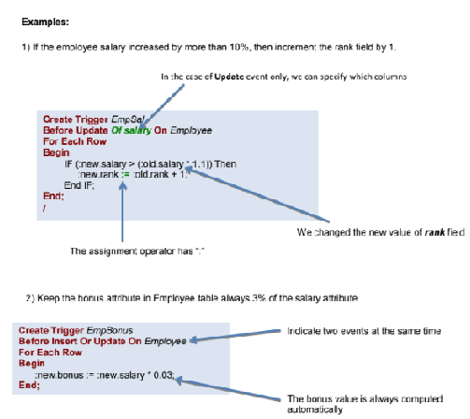

Slide 149
3. Suppose we want to check whenever an employee’s salary is greater than the salary of his or her direct supervisor in the COMPANY database
▪ Several events can trigger this rule:
• inserting a new employee record
• changing an employee’s salary or
• changing an employee’s supervisor

Slide 150
Suppose that the action to take would be to call an external stored procedure SALARY_VIOLATION which will notify the supervisor
CREATE TRIGGER SALARY_VIOLATION
BEFORE INSERT OR UPDATE OF SALARY, SUPERVISOR_SSN
ON EMPLOYEE
FOR EACH ROW
WHEN ( NEW.SALARY > ( SELECT SALARY FROM EMPLOYEE
WHERE SSN = NEW.SUPERVISOR_SSN ) )
INFORM_SUPERVISOR(NEW.Supervisor_ssn,NEW.Ssn );

Slide 151
The trigger is given the name SALARY_VIOLATION, which can be used to remove or deactivate the trigger later
▪ In this example the events are: inserting a new employee record, changing an employee’s salary, or changing an employee’s supervisor
▪ The action is to execute the stored procedure INFORM_SUPERVISOR

Slide 152
Assertions vs. Triggers
▪ Assertions do not modify the data, they only check certain conditions. Triggers are more powerful because the can check conditions and also modify the data
▪ Assertions are not linked to specific tables in the database and not linked to specific events.
Triggers are linked to specific tables and specific events
▪ All assertions can be implemented as triggers (one or more). Not all triggers can be implemented as assertions

Slide 153
Exercise
Write the following queries in SQL.
Find the names of all Juniors (Level = JR) who are enrolled in a class taught by John Borg.
Find the age of the oldest student who is either a History major or is enrolled in a course taught by John Borg.
Find the names of all classes that either meet in room R128 or have five or more students enrolled.
Find the names of all students who are enrolled in two classes that meet at the same time.
Find the names of faculty members who teach in every room in which some class is taught.
Find the names of faculty members for whom the combined enrollment of the courses that they teach is less than five.

Slide 154
Exercise
Write the following queries in SQL.
Print the Level and the average age of students for that Level, for each Level.
Print the Level and the average age of students for that Level, for all Levels except JR.
Find the names of students who are enrolled in the maximum number of classes.
Find the names of students who are not enrolled in any class.
For each age value that appears in Students, nd the level value that appears most often. For example, if there are more FR level students aged 18 than SR, JR, or SO students aged 18, you should print the pair (18, FR).

Slide 155
Exercise
Write the output of the following queries specified on the given table.
People
FirstName | LastName | YearOfBirth
Thomas | Alva Edison | 1847
Benjamin | Franklin | 1706
Thomas | More | 1478
Thomas | Jefferson | 1826
Benjamin | Britten | 1767
Benjamin | Burnley | 1845
SELECT * FROM People ORDER BY FirstName DESC, YearOfBirth ASC
SELECT * FROM People ORDER BY FirstName, YearOfBirth, LastName
SELECT * FROM People ORDER BY FirstName DESC , LastName, ASC , YearOfBirth DESC

Slide 156
Exercise
output.
FirstName | LastName | YearOfBirth
Thomas | More | 1810
Thomas | Alva Edison | 1815
Thomas | More | 1820
Benjamin | Burnley | 1745
Benjamin | Franklin | 1766
Benjamin | Britten | 1767
FirstName | LastName | YearOfBirth
Benjamin | Burnley | 1745
Benjamin | Franklin | 1766
Benjamin | Britten | 1767
Thomas | More | 1810
Thomas | Alva Edison | 1815
Thomas | More | 1820

Slide 157
Exercise
output.
FirstName | LastName | YearOfBirth
Thomas | Alva Edison | 1815
Thomas | More | 1820
Thomas | More | 1810
Benjamin | Britten | 1767
Benjamin | Burnley | 1745
Benjamin | Franklin | 1766

